Slide 1
Displaying Pictures and Menus with Views

Slide 2
Displaying Pictures
We use the following views to display images or pictures in Android UI:
ImageView
ImageSwitcher
GridView

Slide 3
ImageView View
The ImageView is a view that shows images on the device screen.
To display an image using ImageView:
Place the image file in the `res/drawable` or res/mipmap folder of your Android project.
In your XML layout file (e.g., `activity_main.xml`), where you want to add the ImageView, you need to declare the ImageView element.

Slide 4
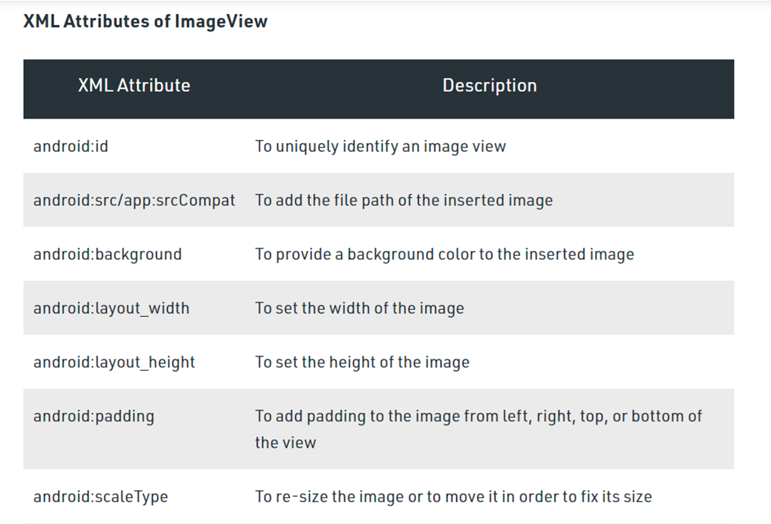

ImageView View

Slide 5
ImageSwitcher
The `ImageSwitcher` is a specialized `ViewSwitcher` that is designed to switch between images smoothly.
To create an image switcher with fade-in and fade-out animations in Android, you can use the `ImageSwitcher` class along with animations.

Slide 6
ImageSwitcher
Place the image file in the `res/drawable` or res/mipmap folder of your Android project.
Define the `ImageSwitcher` in your XML layout file(eg. activity_main.xml).
Create the fade-in and fade-out animations: Create two XML animation files in the `res/anim` folder, one for fade-in and another for fade-out.

Slide 7
ImageSwitcher
In Java Code(eg. MainActivity.java),
Set up the `ImageSwitcher` in the `onCreate` method.
The `imageSwitcher.setFactory()` method is used to provide a factory that creates `ImageView` instances for the `ImageSwitcher`.
Set the initial image and define the click listener to switch between images.

Slide 8

ImageSwitcher
The `imageSwitcher.setInAnimation()` and `imageSwitcher.setOutAnimation()` methods are used to set the fade-in and fade-out animations, respectively.

Slide 9
GridView
`GridView` is a view group in Android that displays items in a two-dimensional, scrollable grid. Items are inserted into this grid layout from a database or from an array.
It is commonly used to show a collection of images, text, or any other views in a grid-like arrangement. Each item in the grid is represented by a cell.
You can use the GridView together with an ImageView to display a series of images.

Slide 10
GridView
To use GridView you need to create the ImageAdapter class (which extends the BaseAdapter class) so that it can bind a series of ImageView views to the GridView.
The ImageAdapter class acts as a bridge between an GridView and the data source that feeds data into it.
Place the image file in the `res/drawable` or res/mipmap folder of your Android project.
Add the ‘GridView’ element in your XML layout file(eg. activity_main.xml).

Slide 11
GridView
In `grid_item_layout.xml`, add an `ImageView` to represent each item in the grid. You can customize it further based on your requirements.
Create an adapter: You need to create an adapter to populate the `GridView` with data. The adapter will handle creating views for each item in the grid.
Set the adapter to the GridView.

Slide 12

GridView

Slide 13
Menus
There are two main types of menus in Android:
Options menu — Displays information related to the current activity. It is displayed as a set of menu items that appear when the user taps the menu button (three vertical dots).
Context menu — Displays information related to a particular view on an activity. It appears when the user long-presses on a view. It provides a set of actions that are contextually relevant to the selected view.

Slide 14
Options menu
Create an XML file in the "res/menu" directory to define the menu items.
In MainActivity.java,inflate the menu XML resource in onCreateOptionsMenu method.
Implement the onOptionsItemSelected method to handle clicks on the menu items.

Slide 15
Context menu
Create an XML file in the "res/menu" directory to define the menu items.
In MainActivity.java, Register the view for the context menu in the onCreate() method.
Override onCreateContextMenu() to create the context menu.
Handle the selected item in onContextItemSelected().

Slide 16
WebView
Webview in Android is a component that allows you to display web content within your Android app.
It acts as an embedded browser, enabling you to load web pages, show web-based features, and interact with web content directly from your application.
Add the necessary permissions in the AndroidManifest.xml file <uses-permission android:name="android.permission.INTERNET" />

Slide 17
WebView
Open your layout XML file (e.g., activity_main.xml) and add the Webview.
In MainActivity.java, find the Webview by its ID and load a web page.

